Slide 1
Study Designs Cross-Sectional & Ecologic
EPID600
Dr. Karin Yeatts
February 5, 2019

Slide 2
Upcoming Assignments
February 8-Team & Lab Peer Evaluation 1
February 8-Team Project Part 1

Slide 3
Team Project Advice
Refine your exposure and outcome ideas as you delve into the literature

Slide 4
Sections | Length | Points | Score
Study hypothesis. Example: “We hypothesize that undergraduate students who text while driving have more car accidents compared with students who don’t text while driving.” | 2 sentences | 5
Public health importance: “Why we should care about this topic?” Does it affect a large proportion of the population? Or are there severe consequences (car crashes related to texting while driving)? Or are vulnerable populations suspected to be at increased risk? | 1-2 paragraphs | 10
Study population: Describe your theoretical and study sample. What sampling frame will you use? Defend the choice of your sampling frame. | 1 paragraph | 10
Prevalence (and incidence if available) of your main exposure in your target population (from the literature). If the exposure prevalence is not known in your target population, then report exposure prevalence in the general population. | 1 paragraph | 10
Prevalence (and incidence if available) of the health outcome in your target population (from the literature). If the health outcome prevalence is not known in your target population, then report the health outcome prevalence in the general population. | 1 paragraph | 10
Association of Exposure and Outcome: describe what has been reported in the peer review literature (PubMed) with regards to the relationship between the selected exposure and the health outcome in your target population (or if not known, the general population). | 1 paragraph | 10
Contributing factors: Describe how the relationship varies depending on three key variables, such as demographic variables age, sex, or education (variables for which you can collect data). Describe existing evidence on how these variables influence the relationship between your exposure and outcome. | Up to one page | 15
Works cited: include 5 valid peer-reviewed references. Cite in text and include in reference section. | 1 page | 10
Style/writing | --- | 10
Peer evaluation | --- | 10
Total |  | 100

Slide 5
Student Questions
What’s a categorical vs. a continuous variable?
How do I do a literature search?
What are “covariates”?
(in a statistical model Y= b0 + b1x1 + b2x2 + b3x3 + b4x4..
Outcome(Y) =exposure (b1) + covariate (b2) + covariate (b3) + covariate (b4)..

Slide 6
Course Objectives
Explain the importance of epidemiology for informing scientific, ethical, economic and political discussion of health issues.
Describe a public health problem in terms of person, place, and time.
Apply the basic terminology and definitions of epidemiology.
Calculate basic epidemiology measures.
Identify key sources of data for epidemiologic purposes.
Evaluate the strengths and limitations of epidemiologic reports.
Comprehend basic ethical and legal principles pertaining to the collection, maintenance, use and dissemination of epidemiologic data.
Draw appropriate inferences from epidemiologic data.
Identify the principles and limitations of public health screening programs.
Communicate epidemiologic information to lay and professional audiences.
Apply concepts, methods, and tools of public health data collection, analysis and interpretation, and the evidence-based reasoning and informatics approaches that are essential to public health practice.

Slide 7
Class objectives
List characteristics of cross-sectional studies and ecologic studies
Compare advantages and disadvantages of cross-sectional and ecologic studies
Define the "ecologic fallacy.“
Distinguish studies that have individual and/or ecologic characteristics
Identify the “unit of analysis” in a public health related publication

Slide 8
Steps in epidemiologic research
Identify a public health problem
Describe problem, identify gaps, how you will address gap?
Develop a hypothesis
Define exposure, disease
Pick a study design to fit your question
Considerations
Nature of your Exposure and Disease
(rare, common, ease of measuring)
Time Available
Resources, $
Available Datasets to fit research question?

Slide 9
How do you identify the study design in a published study?
Ask these 2 questions:
When were the exposure and outcome measured?
Exposure before outcome?
Outcome before exposure?
Exposure and outcome at same time?
What was the unit of analysis?
Group or individual?

Slide 10
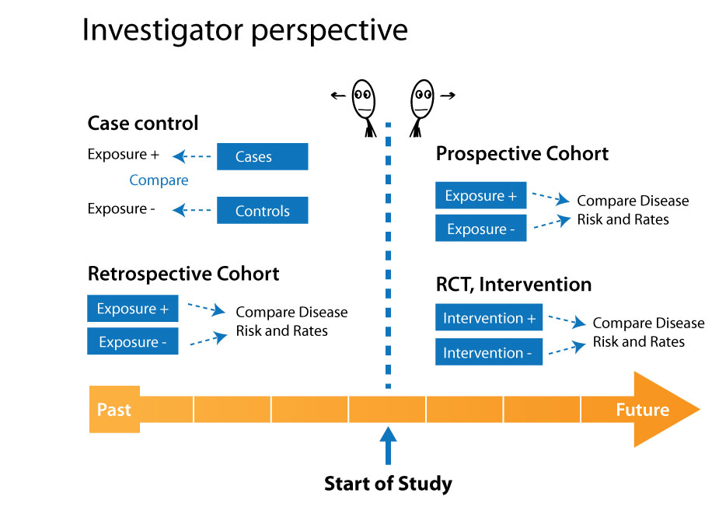

Slide 11
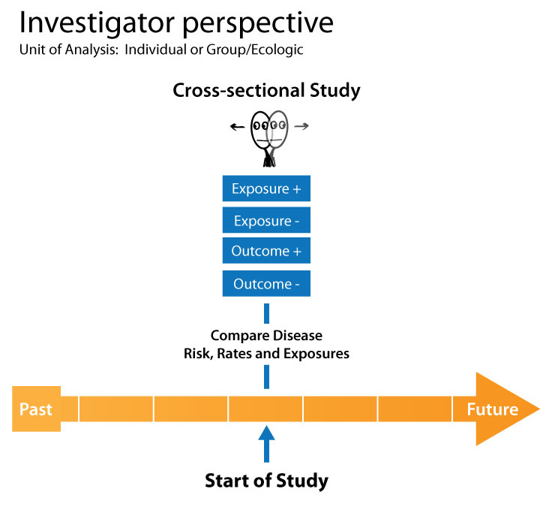

Slide 12
Uses of Cross-Sectional Studies
evaluate the proportion of a population with disease or with risk factors
prevalence of
elevated blood lead in toddlers;
asthma in children
useful for planning or administering preventive or health care services
useful for surveillance programs and for conducting surveys and polls

Slide 13
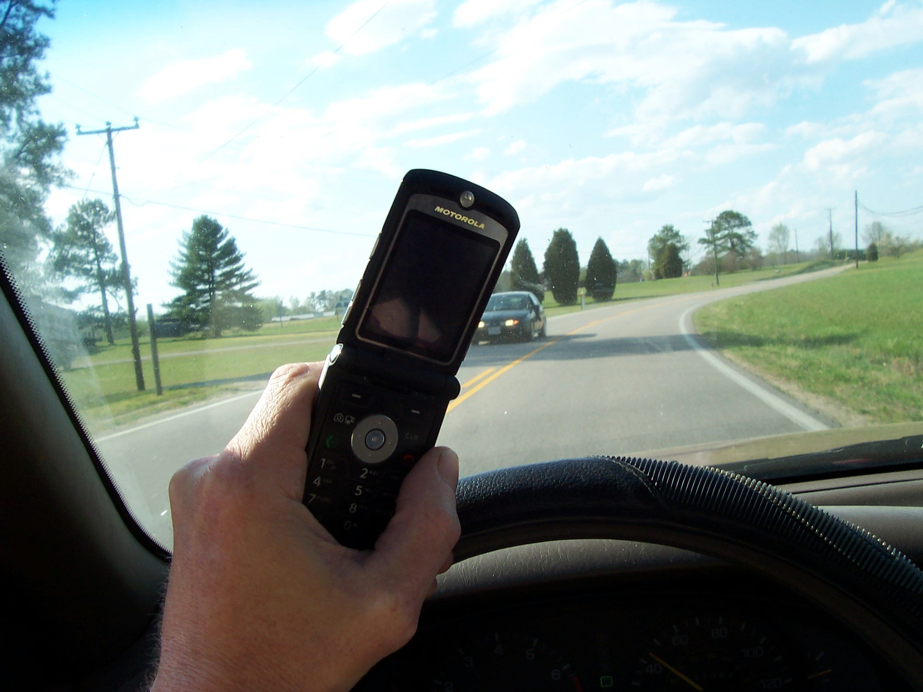
Vera-Lopez et al. 2013
Study: Distracted driving
Population Base: 3 cities in Mexico
Sample: 3% of all intersections with functioning traffic lights; 7,940 drivers
Methods: Drivers observed while driving through intersection
Prevalence: 10.8%
Notes:
A sample of 3% of all intersections with functioning traffic lights in all three cities was randomly selected. With a systematic sampling methodology, 7,940 drivers and their vehicles were observed during 2011-2012. The overall prevalence of mobile phone use while driving was 10.8%.
(Details, not to be read: Only two vehicles per stop light were selected in a systematic manner, depending on the number of lanes: (a) streets with only one lane: the first and the third cars; (b) streets with two lanes: the first car in the left lane and the second car in the right lane; (c) vehicles with three or more lanes: the first car in the leftmost lane and the second car in the subsequent lane to the right. All observations were made by a single staff member trained in the study design and methodology. Observations were carried out during 1 week, on every day of the week and at different times throughout the day (only during daylight hours, from 08:35 to 18:50). )
Study: Distracted driving: mobile phone use while driving in three Mexican cities. Inj Prev. 2013 Aug;19(4):276-9
R= Distracted driving: mobile phone use while driving in three Mexican cities Juan Daniel Vera-López, Ricardo Pérez-Núñez, Martha Híjar, Elisa Hidalgo-Solórzano, Jeffrey C Lunnen, Aruna Chandran, Adnan A Hyder Injury Prevention 2013;19:276–279. accessed 12/12/2013

Slide 14
Uses of Cross-Sectional Studies
useful for studying association of exposure with disease for chronic diseases lacking information on time of onset,
diet and arthritis,
smoking and chronic bronchitis,
asthma prevalence and dust mites
interpretation requires caution regarding temporal association of duration of disease with exposure status

Slide 15
Limitation of Cross-Sectional Studies to Evaluate Risk
Prevalence of disease is influenced both by risk and duration of disease (or survival with disease)
Duration of disease may be influenced by exposure

Slide 16

Interpreting cross-sectional studies
Antecedent-consequent “bias” (chicken vs. egg)
Cannot be sure that the exposure preceded the disease

Slide 17
Measures associated with Cross-sectional studies
Existing # of people with the health outcome
Prevalence =
# of people in the study population
Prevalence Odds Ratio
Prevalence Ratio
Prevalence Difference

Slide 18
Prevalence Ratio & Difference
D
D
PR =
(Prev. _{exp})
(Prev. _{unexp})
E
a
b
(a + b)
(P_{exp}) -
(P_{unexp})
PD =
E
c
d
(c + d)
Prevalence_{exposed} = a/(total exposed) = a/(a + b)
Prevelance_{unexposed} = c/(total unexposed) = c/(c + d)

Slide 19
Prevalence Odds Ratio
D
D
POR =
(Prev. odds _{exp})
(Prev. odds _{unexp})
E
a
b
(a + b)
POR = a/c b/d = ad/bc
E
c
d
(c + d)
Prevalence odds_{of exposure among diseased} = a/c
Prevalence odds_{of exposure among non diseased} = b/d
Prevalence ratio more appropriate to use when outcome is “common” (greater than 10%)

Slide 20
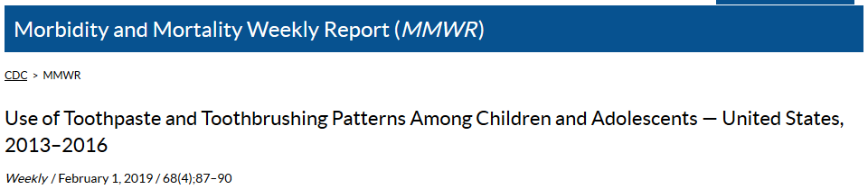
Example
Abstract. Fluoride use is one of the main factors responsible for the decline in prevalence and severity of dental caries and cavities (tooth decay) in the United States (1). Brushing children's teeth is recommended when the first tooth erupts, as early as 6 months, and the first dental visit should occur no later than age 1 year (2-4). However, ingestion of too much fluoride while teeth are developing can result in visibly detectable changes in enamel structure such as discoloration and pitting (dental fluorosis) (1). Therefore, CDC recommends that children begin using fluoride toothpaste at age 2 years. Children aged <3 years should use a smear the size of a rice grain, and children aged >3 years should use no more than a pea-sized amount (0.25 g) until age 6 years, by which time the swallowing reflex has developed sufficiently to prevent inadvertent ingestion. Questions on toothbrushing practices and toothpaste use among children and adolescents were included in the questionnaire component of the National Health and Nutrition Examination Survey (NHANES) for the first time beginning in the 2013-2014 cycle. This study estimates patterns of toothbrushing and toothpaste use among children and adolescents by analyzing parents' or caregivers' responses to questions about when the child started to brush teeth, age the child started to use toothpaste, frequency of toothbrushing each day, and amount of toothpaste currently used or used at time of survey. Analysis of 2013-2016 data found that >38% of children aged 3-6 years used more toothpaste than that recommended by CDC and other professional organizations. In addition, nearly 80% of children aged 3-15 years started brushing later than recommended. Parents and caregivers can play a role in ensuring that children are brushing often enough and using the recommended amount of toothpaste.

Slide 21
Ecologic Studies
Unit of observation is a group or population, not individuals
Exposure and risk factors are known only at the group level, e.g. average air pollution concentration in different cities
Notes:
We don’t know whether individuals who died in City A
had higher or lower exposure than individuals in City A
who remained alive.
Example: did the nonsmokers who died from lung cancer
in City A have more or less exposure to the ambient air
pollution of City A than nonmokers of the same age in City
A who did not die of lung cancer?

Slide 22

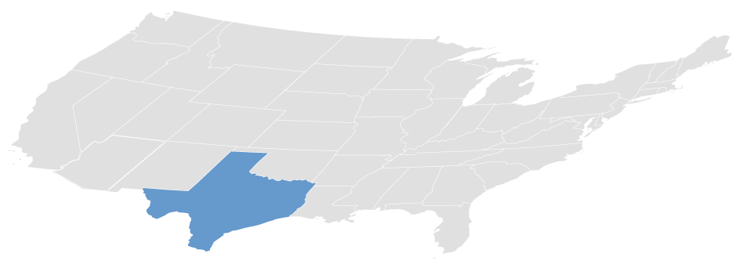
Unit of Analysis
Individual
Community
Notes:
https://www.youtube.com/watch?v=jbkSRLYSojo, Hans Rosling’s 200 Countries, 200 Years, 4 minutes

Slide 23

Does the study have ecologic (group) level measurements?
Is information based on information from individuals?
Or averages of populations? (group)
NZ
Colon cancer, risk per 100,000
USA
Swe
Chi
Pol
Nig
Jap
40 80 120 160 200 240 280 320
Per capita daily consumptions-Grams of Fat

Slide 24
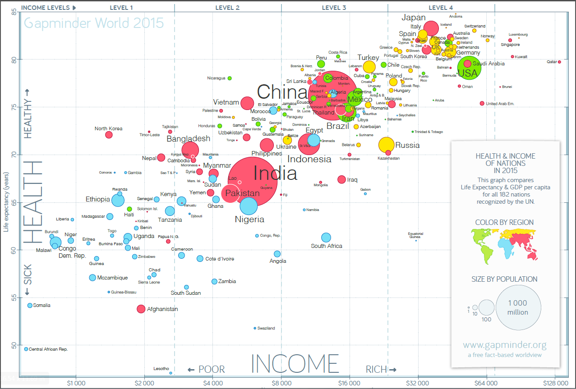

Slide 25
Key Features (modified from Aschengrau)
“ A classic ecologic study examines occurrence of a disease in relation to a factor described on a population level. “
Population (group) is the unit of analysis
An exposure status that is a property of the population [a group measure]”

Slide 26
Examples of group level exposures, outcomes
Laws, Policies
Medicaid Expansion, ACA
Country level GDP
Environmental exposures can sometimes be measured at the group level
A country’s maternal mortality rate

Slide 27
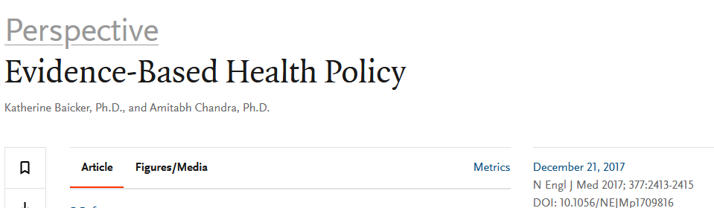
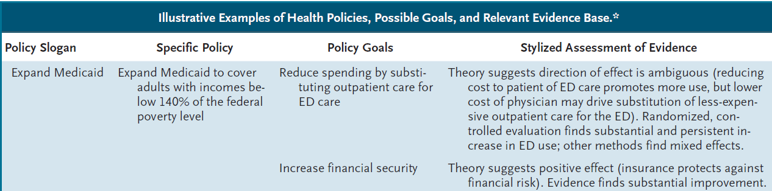
Example
Notes:
http://www.nejm.org/doi/full/10.1056/NEJMp1709816

Slide 28
Time Frames and Measures of Occurrence in Ecologic Studies
One point in time (cross-sectional)
Prevalence
Multiple points in time (time trend)
Rates, risks
Notes:
https://www.gapminder.org/downloads/mdg-4-reducing-child-mortality/

Slide 29
Measures of Association for Ecologic Studies
Ratios
Differences
Prevalence
Prevalence odds
Risk
Rates
Prevalence
Risk
Rates

Slide 30
Cross sectional Study, Individual level measurements
Investigator Perspective

Slide 31


Cross-sectional Ecologic Study Design
Slice in Time
Group, population exposure and/or outcome
Investigator Perspective

Slide 32
Time Series/ Longitudinal Ecologic Study Design
Group, population exposure and/or outcome
Investigator Perspective

Slide 33

Ecologic Study Example
Have seat belt laws made a difference in motor vehicle fatality rates, comparing years before and after laws were passed?

Slide 34
Ecologic study- example
Health Disparities
Effect of Jim Crowe laws
The unique impact of abolition of Jim Crow laws on reducing inequities in infant death rates and implications for choice of comparison groups in analyzing societal determinants of health.
Krieger N, Chen JT, Coull B, Waterman PD, Beckfield J.
Am J Public Health. 2013 Dec;103(12):2234-44.

Slide 35
Ecologic Fallacy
Definition:
concluding that an association between exposure and disease at group level is therefore true at individual level
Notes:
Contrast group (aggregate) level information
with individual level information:
Group
level
More exposed
individuals
in City A
Less exposed
individuals
in City A
Died
Alive
Died
Alive
Individual
level

Slide 36
Ecologic Fallacy
Cause of the fallacy: we do not know the link between exposure and disease among individuals within each group,
don’t know the number of diseased individuals who were exposed or not exposed in the high exposure group
nor in the low exposure group

Slide 37
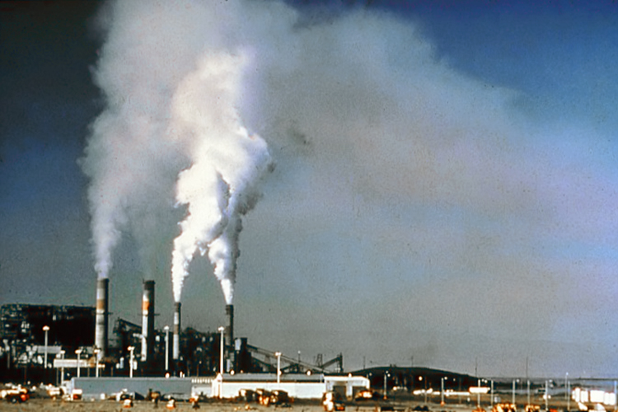
Hypothetical Study: Air pollution and lung disease
Air pollution is higher in Los Angeles than in Denver.
Mortality from lung disease is lower in Los Angeles than Denver.
Fallacious Conclusion: Air pollution protects against lung disease deaths.
Notes:
We might come to the fallacious conclusion that air pollution protects against lung disease deaths. The explanation may be that persons dying of lung disease in Denver may have moved from high air pollution cities; we don’t know the cumulative exposures of cases and non-cases in either city.
R= ERIC NOTEBOOK VERSION 2 ecologic studies
Carl Shy Epid 160 Slides

Slide 39
Arsenic in drinking water and prostate cancer in Illinois counties: An ecologic study.
C.M. Bulkaetal./EnvironmentalResearch148(2016)450–456

Slide 40
Ecologic Studies: Advantages
Group data is publicly available
Lower cost; convenient
Useful for evaluating impact of community-level interventions
Maximize exposure differences between communities
Studying effects of short-term variations in exposure within the same community
Notes:
Another advantage of an ecologic study is that this study design can maximize exposure differences between communities when minimal within-community differences render individual-risk studies impractical, whereas exposures may differ substantially between communities (cities, states, countries), e.g. effect of latitude on risk of multiple sclerosis
Ecologic studies are also useful for studying effects of short-term variations in exposure within the same community, e.g. temperature and mortality

Slide 41
Ecologic Studies: Limitations
Ecologic fallacy
Cannot be confident that exposure precedes outcome (in cross-sectional ecologic studies)
Migration into and out of communities can bias interpretation of data

Slide 42
What kind of study is this? Estimates of meteorological variability in association with dengue cases in a coastal city in northern Vietnam Glob Health Action. 2014 Dec 8;7:23119
BACKGROUND:
Dengue fever (DF) is a vector-borne disease that is sensitive to weather and climate variability. To date, however, this relationship in coastal northern Vietnam has not been well documented.
OBJECTIVES:
This paper aims to examine the associations between meteorological variables and dengue incidence in Haiphong, Vietnam, over the period 2008-2012.
METHODS:
Monthly data on dengue incidence from all commune health stations and hospitals of Haiphong (with a total population of ~1.8 million) were obtained in accordance with the WHO's recommendations over a 5-year period (2008-2012). Temperature, rainfall, and humidity were recorded as monthly averages by local meteorological stations. The association between weather variables and dengue cases was assessed using a Poisson regression model.
RESULTS:
From 2008 through 2012, 507 cases of dengue were reported. The risk of dengue was increased by sevenfold during the September-December period compared with other months over the period 2008-2012. In the multivariable Poisson regression model, an increased risk of dengue was independently associated with months with a higher amount of rainfall (RR=1.06; 95% CI 1.00-1.13 per 50 mm increase) and higher humidity (RR=1.05; 95% CI 1.02-1.08 per 1% increase).
CONCLUSION:
These data suggest that rainfall and relative humidity could be used as ecological indicators of dengue risk in Haiphong. This study may provide baseline information for identifying potential long-term effects and adaptation needs of global climate change on dengue in the coming decades.
(edited)

Slide 43
What kind of study is this? Beverage consumption in Brazil: results from the first National Dietary Survey.
Pereira RA¹, Souza AM², Duffey KJ³, Sichieri R², Popkin BM³. Public Health Nutr. 2014 Aug 27:1-9.
OBJECTIVE: To provide an overview of beverage consumption patterns using the first nationally representative survey of dietary intake in Brazil.
DESIGN: Beverage consumption data were obtained by 1 d food records in an individual dietary survey.
SETTING: Nationwide survey, 2008-2009.
SUBJECTS: Nationally representative sample of individuals aged ≥10 years (n 34 003).
RESULTS:
Beverages contributed 17·1 % of total energy consumption. Caloric coffee beverages provided the greatest level of energy overall (464 kJ (111 kcal)/d). Individuals aged 10-18 years (243 kJ (58 kcal)/d) and 19-39 years (230 kJ (55 kcal)/d) consumed a higher proportion of energy from sugar-sweetened soft drinks than individuals over this age (142 kJ (34 kcal)/d for those aged 40-59 years and 79 kJ (19 kcal)/d for those aged ≥60 years).
CONCLUSIONS:
Overall, the contribution of beverages, particularly sugary beverages, to total energy consumption in Brazil represents an important public health challenge and is comparable with those from other countries
(edited)

Slide 44

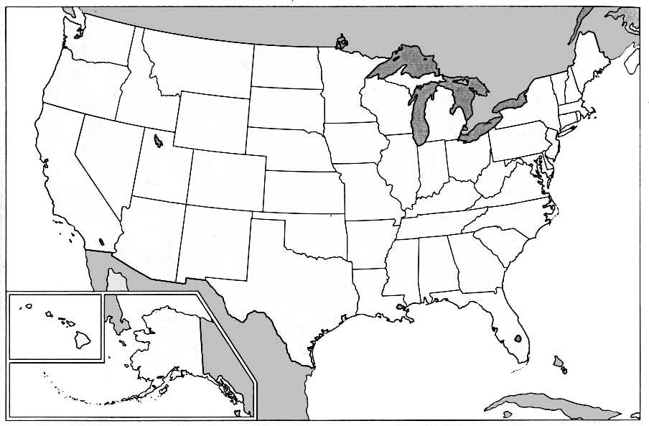
Lab Journal Article
Fleegler EW, Lee LK, Monuteaux MC, Hemenway D, Mannix R. Firearm Legislation and Firearm-Related Fatalities in the United States. JAMA Intern Med. 2013;173(9):732-740.
.

Slide 45
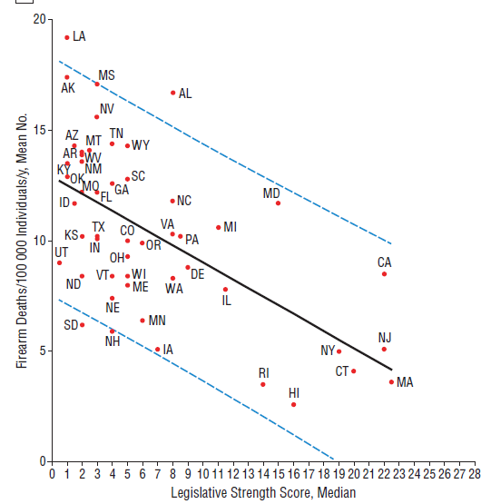
Notes:
http://fivethirtyeight.com/features/gun-deaths/

